Slide 1
TECH TALK - SAE J1772 and OpenEVSE
Presented by: Christopher Howell

Slide 2
TECH TALK - SAE J1772 and OpenEVSE
Electric Vehicle Supply Equipment
SAE J1772 Recommended Practice
Open Source Hardware - OpenEVSE
Technology Development
TMC Connect 2015 | Santa Clara, CA

Slide 3
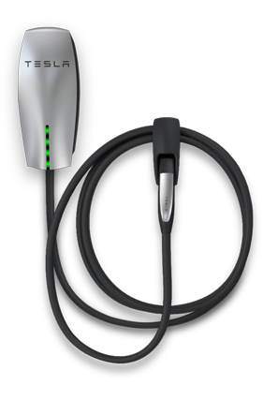
Electric Vehicle Supply Equipment (EVSE)
The EVSE provides several safety features:
Smart Power Cord…
Power pins not hot until negotiation
Graceful start-up/shut-down
Ground verification
Protection against shock
Plug rated for many plug-in /disconnect cycles
TMC Connect 2015 | Santa Clara, CA

Slide 4
Safety – SAE J1772, UL 2231-2 and NEC
The EVSE provides safety features and verification of critical features:
Charge Circuit Interruption Device (CCID)
Welded Contact Detection (verification for CCID)
Ground Fault Circuit Interrupt (GFCI)
GFCI Self Test (verification for GFCI)
Pilot Signal Level and Duty Cycle
Ground Monitor Interrupter (GMI) verification for ground
TMC Connect 2015 | Santa Clara, CA

Slide 5
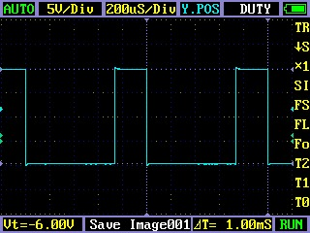
Electric Vehicle Supply Equipment (EVSE)
The J1772 Pilot is a 1khz +12V to -12V square wave, the voltage defines the state. The EV adds resistance pilot to Ground to vary the voltage. The EVSE reads the voltage and changes state accordingly.
State | Pilot High | Pilot Low | Frequency | EV | Description
State A | +12V | N/A | DC | N/A | Not Connected
State B | +9V | -12V | 1000hz | 2.74k | EV Connected (Ready)
State C | +6V | -12V | 1000hz | 882 | EV Charge
State D | +3V | -12V | 1000hz | 246 | EV Charge Vent. Required
State E | 0V | 0V | N/A |  | Error
State F | N/A | -12V | N/A |  | Unknown/Error
TMC Connect 2015 | Santa Clara, CA

Slide 6
Electric Vehicle Supply Equipment (EVSE)
The J1772 Pilot Duty cycle (time ratio high state vs low state) determined the maximum available current. The EVSE sets the duty cycle the EV must comply to original setting or changes to the duty cycle.
Amp | Duty Cycle | Amp | Duty Cycle
6A | 10% | 40A | 66%
12A | 20% | 48A | 80%
18A | 30% | 65A | 90%
24A | 40% | 75A | 94%
30A | 50% | 80A | 96%
6A - 51A
Amps = Duty cycle x 0.6
Duty cycle = Amps / 0.6
51A - 80A
Amps = (Duty Cycle - 64) 2.5
Duty cycle = (Amps / 2.5) + 64
TMC Connect 2015 | Santa Clara, CA

Slide 7
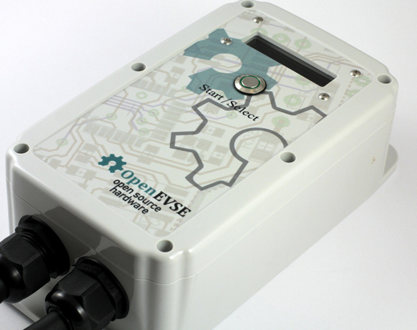
OpenEVSE
OpenEVSE is a open source Electric Vehicle SAE J1772 Charging Station for DIY builders and OEMs.
Hardware, Firmware and documentation fully Open Source (commercial use allowed)
Fully supports SAE J1772 Recommended Practice
Software adjustable pilot (6A – 80A)
Built in GFCI with 20ma trip point
Ground verification and Stuck Relay detection
Supports all J1772 states including “ventilation required and Diode check”
AC L1 – L2 auto-detect current setting for each
TMC Connect 2015 | Santa Clara, CA

Slide 8
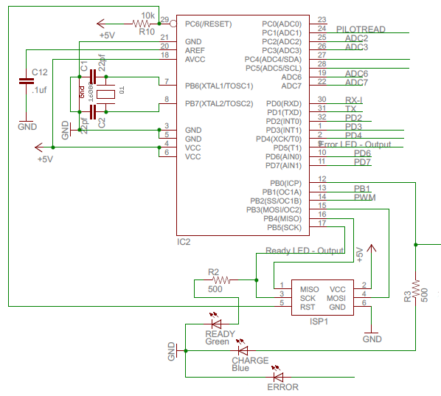
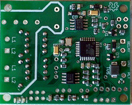
OpenEVSE MPU
OpenEVSE is based on the ATMEL AVR:
8-bit microprocessor
16mhz @ 5v
Compatible with Arduino IDE
TMC Connect 2015 | Santa Clara, CA

Slide 9
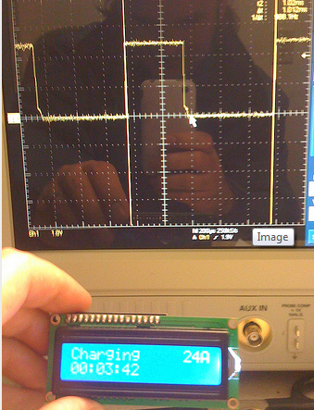
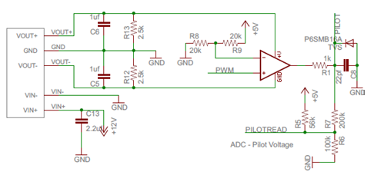
OpenEVSE Pilot
The OpenEVSE pilot uses a 1w DC/DC converter to generate +12v and -12v.
The Opamp takes the 1khz pilot from the microprocessor 0 – 5v and switched -12v to +12v.
The pilot is read by the microprocessor, R5 – R6 – R7 scale the -12v - +12v signal to 0 – 5v.
TMC Connect 2015 | Santa Clara, CA

Slide 10
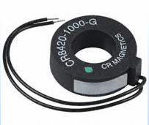
OpenEVSE GFCI
GFCI measures the difference of current going in vs. current going out.
The circuit “trips” if an imbalance of > 20ma.
The output of the fault line is monitored by the microprocessor as an interrupt.
A self test loop runs through the coil 5 times to run self test on boot and every time before closing the contactor.
TMC Connect 2015 | Santa Clara, CA

Slide 11
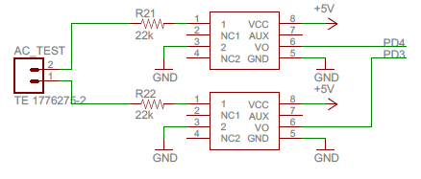
OpenEVSE AC Detect
OpenEVSE uses 2 Optical Isolators to detect the presence of voltage on each AC line.
A small current is sent from each hot to ground.
The AC_Test leads are connected load side to allow welded relay detection as well as GMI and L1/L2 auto-detection.
1 | 2
L | L | L2
L | H | L1
H | L | L1
H | H | Bad Ground
TMC Connect 2015 | Santa Clara, CA

Slide 12
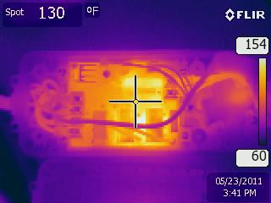
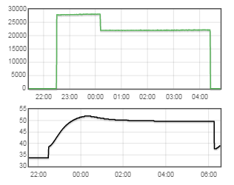
OpenEVSE Temperature
Temperature Monitoring and Throttling
OpenEVSE monitors internal temperature
Ambient and infrared sensors supported over i2c
As temperature increases current is reduced by 25% - 50% - 75% - Shutdown
Starts throttling at 57°C (135°F)
TMC Connect 2015 | Santa Clara, CA

Slide 13
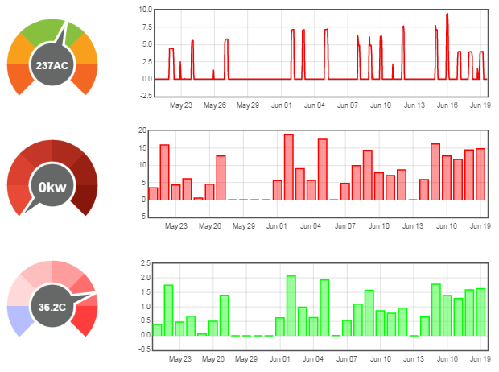
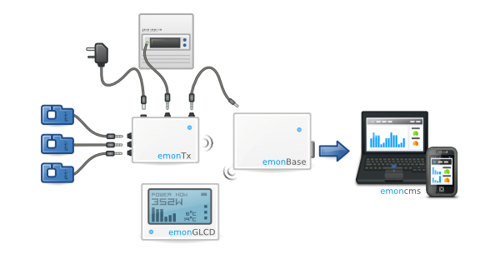
OpenNRG
Energy Monitoring
Based on Open Energy Monitor
OpenEVSE records current, temperature and state
OpenNRG records voltage, current and temperature
Data fusion with EVSE, EV, utility be obtained from EV
WiFi – http://data.openevse.com
TMC Connect 2015 | Santa Clara, CA

Slide 14
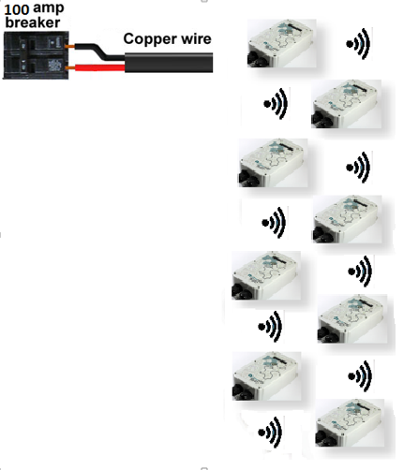
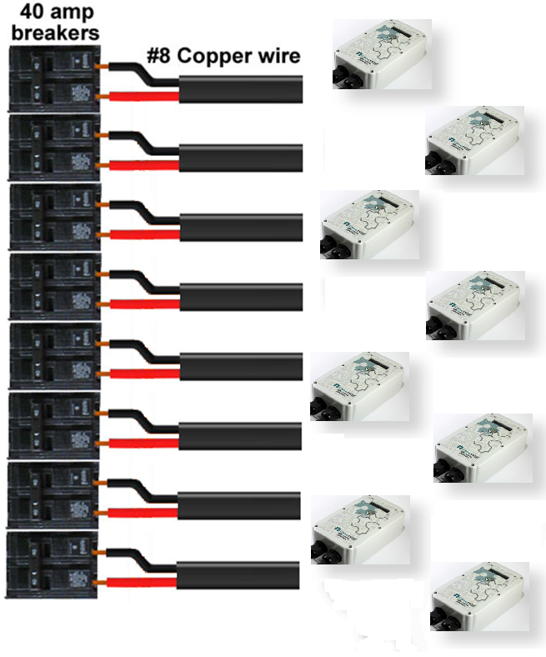
OpenEVSE Dynamic Current
Infrastructure is expensive, Smart EVSEs share a circuit and share load.
J1772 allows for dynamic current settings
Vehicles with low current requirement of those finished can give capacity to those who need it
Example: 8 - 30A EVSE sharing 100A circuit
TMC Connect 2015 | Santa Clara, CA

Slide 15
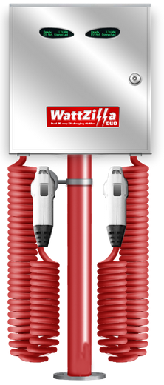
Liquid Sky - WattZilla
WattZilla DUO is the world’s first dual 80-amp electric vehicle charging station capable of charging two electric vehicles at 80 AMPS simultaneously.
UL listed 80A Dual and Single
Developed with OpenEVSE components and UL listed by Liquid Sky LLC.
Stainless Steel Construction - Made in USA - Built to last!
TMC Connect 2015 | Santa Clara, CA

Slide 16
TECH TALK - SAE J1772 and OpenEVSE

